Slide 1
Displaying Dialogs
Part of the sources for the following slides from developer.android.com

Slide 2
Overview
Discuss ways for incorporating dialogs into your application
Explore the different types of dialogs in the Android SDK
Work with dialogs and dialog fragments
Work with the Support Package dialog fragments

Slide 3
Dialogs
A dialog is a small window that prompts the user to make a decision or enter additional information.
A dialog does not fill the screen and is normally used for modal events that require users to take an action before they can proceed.

Slide 4
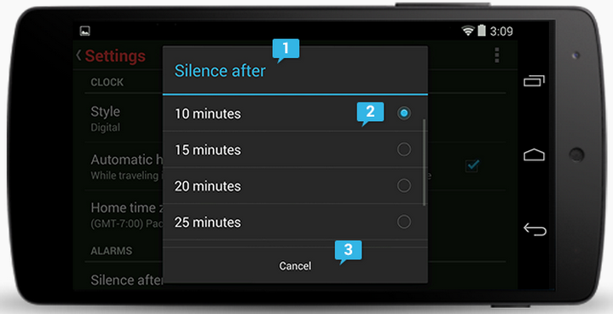
Dialogs
1. Optional title region
The title introduces the content of your dialog. To let user understand about the dialog.
2. Content area
Dialog content varies widely. The content may consist solely of text that provides further context for a user decision. You can includes control such as slider or radio buttons here.
3. Action buttons
Action buttons are typically Cancel and/or OK, with OK indicating the preferred or most likely action. Use active verbs for the label. Order actions following these rules:
  The dismissive action of a dialog is always on the left. Dismissive actions return to the user to the previous state.
  The affirmative actions are on the right. Affirmative actions continue progress toward the user goal that triggered the dialog.

Slide 5
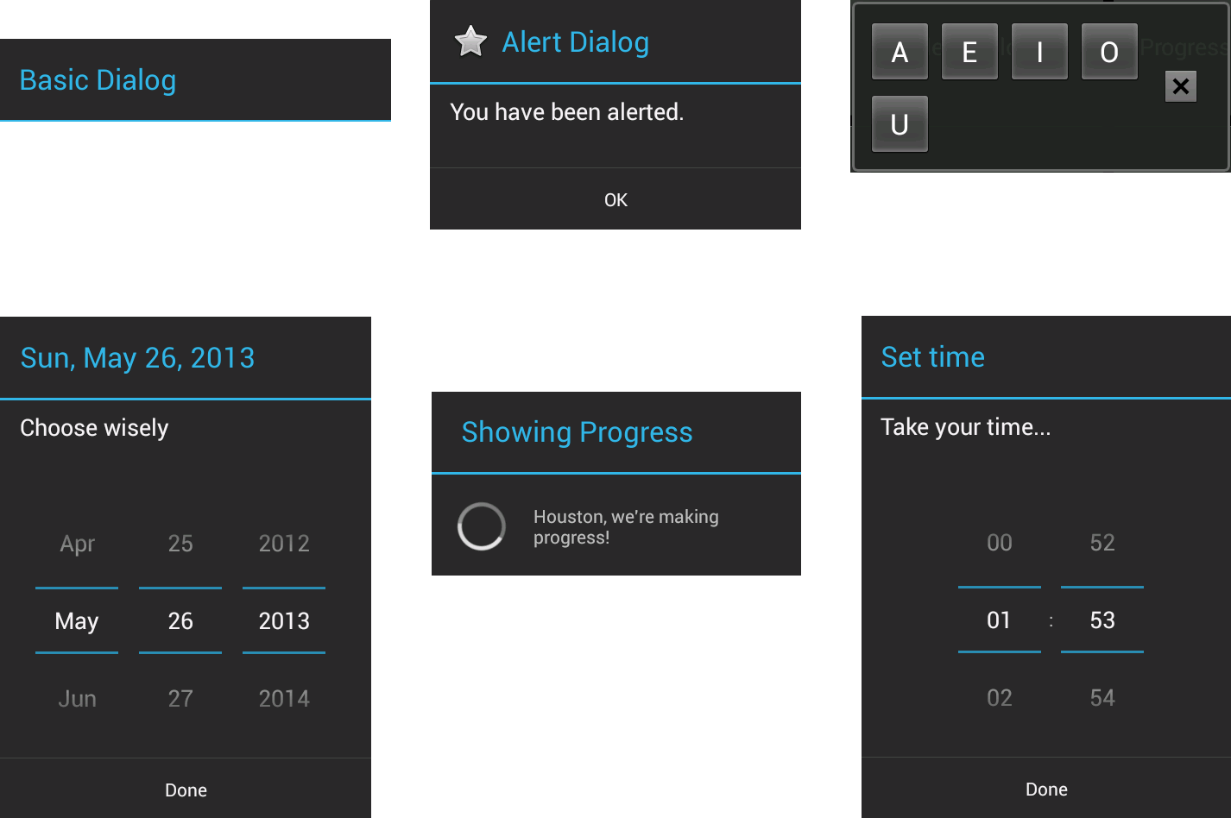
Different Types of Dialogs
Notes:
A sample of different Dialog types available in Android.
Top left is a Dialog, top center is an AlertDialog, top right is a CharacterPickerDialog, bottom left is a DatePickerDialog, bottom center is a ProgressDialog, and bottom right is a TimePickerDialog.

Slide 6
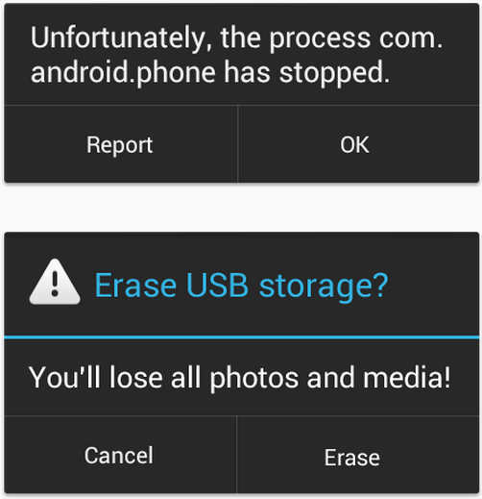
Alerts Dialog
Alerts inform the user about a situation that requires their confirmation or acknowledgement before proceeding.
Alerts without title bars
Most alerts don't need titles. Usually the decision doesn't have a severe impact and can be summed up succinctly in a sentence or two.
Alerts with title bars
Use alerts with title bars sparingly. They are appropriate only when a high-risk operation involving potential loss of data, connectivity, extra charges, and so on requires a clear question or statement (the title) and some additional explanation (in the content area).

Slide 7
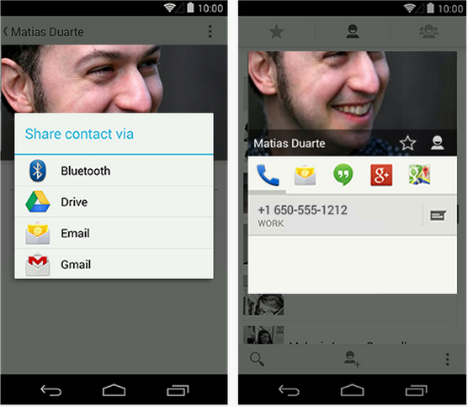
Popups
Popups are lightweight version of dialogs that require a single selection from the user.
Popups don't have explicit buttons that accept or cancel the operation. Instead, making a selection advances the workflow, and simply touching outside the popup dismisses it.

Slide 8
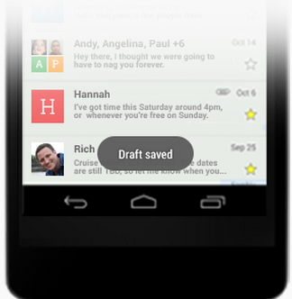
Toasts
Toasts provide lightweight feedback about an operation in a small popup.
Toasts automatically disappear after a timeout.
Context context = getApplicationContext();
CharSequence text = "Hello toast!";
int duration = Toast.LENGTH_SHORT;
Toast toast = Toast.makeText(context, text, duration);
toast.show();

Slide 9
Choosing Your Dialog Implementation
There are two methods for incorporating dialogs into your application
  The legacy method
  The currently recommended method

Slide 10
Choosing Your Dialog Implementation
The legacy method, which has existed since the first Android SDK was released, uses an Activity class that manages its own dialogs in a dialog pool
Dialogs are created, initialized, updated, and destroyed using Activity class callback methods
Dialogs are not shared among activities
This type of Dialog implementation works for all versions of the Android platform
  However, many of the methods used in this type of solution have been deprecated as of API Level 13 (Android 3.2)
The Android API Guides no longer discuss using this legacy method for adding dialogs to an application
Continuing to use the deprecated Activity Dialog methods is not recommended

Slide 11
Choosing Your Dialog Implementation
Using the Fragment-based method, which was introduced in API Level 11 (Android 3.0), dialogs are managed using the FragmentManager class (android.app.FragmentManager)
Dialogs become a special type of Fragment that must still be used within the scope of an Activity class, but its lifecycle is managed like that of any other Fragment
This type of Dialog implementation works with the newest versions of the Android platform
Fragment-based dialogs are backward compatible with older devices as long as you incorporate the latest Android Support Package into your application
Fragment-based dialogs are the recommended choice for moving forward with the Android platform

Slide 12
Different Types of Dialogs
A number of different Dialog types are available within the Android SDK
  Dialog (Superclass)
  AlertDialog
  CharacterPickerDialog
  DatePickerDialog
  ProgressDialog
  TimePickerDialog
  Presentation
You can create custom Dialog windows with your specific layout requirements
Notes:
Dialog
The basic class for all Dialog types (android.app.Dialog).
AlertDialog
A Dialog with one, two, or three Button controls (android.app.AlertDialog).
CharacterPickerDialog
A Dialog for choosing an accented character associated with a base character (android.text.method.CharacterPickerDialog).
DatePickerDialog
A Dialog with a DatePicker control (android.app.DatePickerDialog).
ProgressDialog
A Dialog with a determinate or indeterminate ProgressBar control (android.app.ProgressDialog).
TimePickerDialog
A Dialog with a TimePicker control (android.app.TimePickerDialog).
Presentation
Added in API Level 17, a Presentation (android.app.Presentation) Dialog is a type of Dialog used for presenting content to a secondary display.

Slide 13
Working with Dialogs and Dialog Fragments
An Activity can use dialogs to organize information and react to user-driven events
  For example, an Activity might display a dialog informing the user of a problem or asking the user to confirm an action such as deleting a data record
Using dialogs for simple tasks helps keep the number of application activities manageable
Most Activity classes should be “Fragment aware”
In most cases dialogs should be coupled with user-driven events within specific fragments
There is a special subclass of Fragment called a DialogFragment (android.app.DialogFragment) that can be used for this purpose
A DialogFragment is the best way to define and manage dialogs within your user interface

Slide 14
Tracing the Lifecycle of a Dialog and DialogFragment
Each Dialog must be defined within the DialogFragment in which it is used
A Dialog may be launched once or used repeatedly
Understanding how a DialogFragment manages the Dialog lifecycle is important to implementing a Dialog correctly

Slide 15
Tracing the Lifecycle of a Dialog and DialogFragment
The Android SDK manages dialog fragments in the same way that fragments are managed
We can also be sure that a DialogFragment follows nearly the same lifecycle as a Fragment
Here are the key methods that a DialogFragment must use to manage a Dialog:
  The show() method
    Used to display the Dialog
  The dismiss() method
    Used to stop showing the Dialog

Slide 16
Tracing the Lifecycle of a Dialog and DialogFragment
Adding a DialogFragment with a Dialog to an Activity involves several steps:
  Define a unique class that extends DialogFragment(Source code)
    You can define this class within your Activity, but if you plan to reuse this DialogFragment in other activities, define this class in a separate file
    This class must define a new DialogFragment class method that instantiates and returns a new instance of itself
  Define a Dialog within the DialogFragment class
    Override the onCreateDialog() method and define your Dialog here and simply return the Dialog from this method
    There are various Dialog attributes you are able to define for your Dialog using methods such as setTitle(), setMessage(), or setIcon()
    Simply return the Dialog from this method
  In your Activity class, instantiate a new DialogFragment instance, and once you have the DialogFragment instance, show the Dialog using the show() method

Slide 17
Defining a DialogFragment
A DialogFragment class can be defined within an Activity or within a Fragment
The type of Dialog you are creating will determine the type of data that you must supply to the Dialog definition inside the DialogFragment class

Slide 18
Setting Dialog Attributes
A Dialog is not too useful without its contextual elements being set
One way of doing this is to define one or more of the attributes made available by the Dialog class
The base Dialog class and all of the Dialog subclasses define a setTitle() method
Setting the title usually helps a user determine what the Dialog is used for
The type of Dialog you are implementing determines the methods that are made available to you for setting different Dialog attributes

Slide 19
Showing a Dialog
You can display any Dialog within an Activity by calling the show() method of the DialogFragment class on a valid DialogFragment object identifier

Slide 20
Dismissing a Dialog
Most types of dialogs have automatic dismissal circumstances
If you want to force a Dialog to be dismissed, simply call the dismiss() method on the Dialog identifier

Slide 21
DialogFragment Example
public static class AlertDialogFragment
extends DialogFragment {
public static AlertDialogFragment newInstance() {
AlertDialogFragment newInstance =
new AlertDialogFragment();
return newInstance;
}
...
}
Notes:
Here is a DialogFragment class that implements a class method for instantiating a new instance of itself.

Slide 22
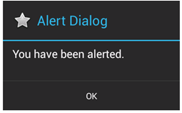
DialogFragment Example
public static class AlertDialogFragment extends DialogFragment {
...
@Override
public Dialog onCreateDialog(Bundle savedInstanceState) {
AlertDialog.Builder alertDialog =
new AlertDialog.Builder(getActivity());
alertDialog.setTitle("Alert Dialog");
alertDialog.setMessage("You have been alerted.");
alertDialog.setIcon(android.R.drawable.btn_star);
alertDialog.setPositiveButton(android.R.string.ok,
new DialogInterface.OnClickListener() {
@Override
public void onClick(DialogInterface dialog, int which) {
Toast.makeText(getActivity(), "Clicked OK!",
Toast.LENGTH_SHORT).show();
return;
}
});
return alertDialog.create();
}
}
Notes:
And here is the onCreateDialog method, where a new AlertDialog is created for our Activity.
Many attributes are set to define how the Dialog will be displayed, and there is also an onClick listener defined that will display a Toast message when the user clicks the positive Button from the Dialog, the positive button being a button such as “OK” or “Accept” for proceeding with the requested action, as opposed to a negative action such as “Cancel” denoting that you do not want to proceed with the requested action.

Slide 23
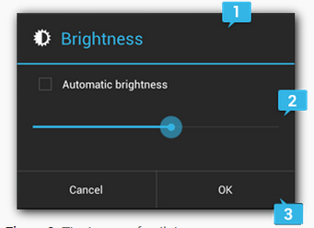
Building an Alert Dialog
Title
This is optional and should be used only when the content area is occupied by a detailed message, a list, or custom layout. If you need to state a simple message or question, you don't need a title.
Content area
This can display a message, a list, or other custom layout.
Action buttons
There should be no more than three action buttons in a dialog.

Slide 24
AlertDialog.Builder
The AlertDialog.Builder class provides APIs that allow you to create an AlertDialog with these kinds of content, including a custom layout.
Steps:
// 1. Instantiate an AlertDialog.Builder with its constructor
AlertDialog.Builder builder = new AlertDialog.Builder(getActivity());
// 2. Chain together various setter methods to set the dialog characteristics
builder.setMessage(R.string.dialog_message)
.setTitle(R.string.dialog_title);
// 3. Get the AlertDialog from create()
AlertDialog dialog = builder.create();

Slide 25
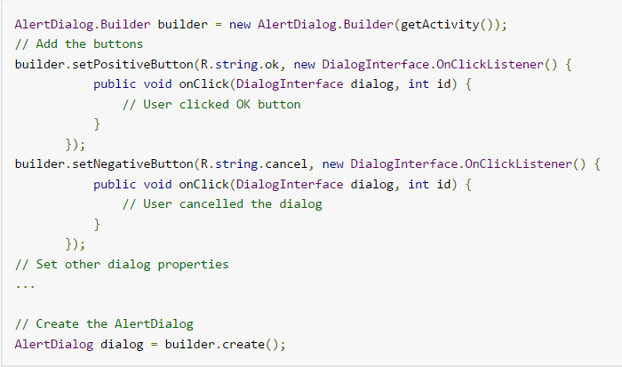
Buttons in AlertDialog
PositiveButton (Right side)
NegativeButton (Left Side)
NeutralButton(Central) (“Remind me later”)

Slide 26
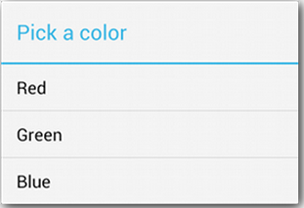
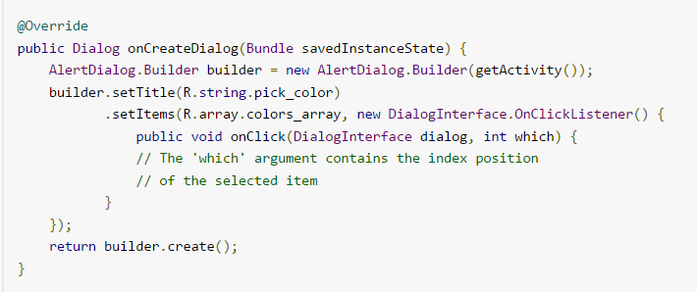
List in AlertDialog
There are three kinds of lists available
  A traditional single-choice list
  A persistent single-choice list (radio buttons)
  A persistent multiple-choice list (checkboxes)
Use setItems() method
Create ONLY List OR Message

Slide 27
DialogFragment Example
  public class SimpleFragDialogActivity extends Activity {
  @Override
  public void onCreate(Bundle savedInstanceState) {
  super.onCreate(savedInstanceState);
  setContentView(R.layout.main);
  // Handle Alert Dialog Button
  Button launchAlertDialog =
  (Button) findViewById(R.id.Button_AlertDialog);
  launchAlertDialog.setOnClickListener(new View.OnClickListener() {
  @Override
  public void onClick(View v) {
  DialogFragment newFragment =
  AlertDialogFragment.newInstance();
  showDialogFragment(newFragment);
  }
  });
  }
  ...
  }
Notes:
Here’s an example of a simple class called SimpleFragDialogActivity that illustrates how to implement a Dialog control that is launched when a Button called Button_AlertDialog (defined in a layout resource) is clicked.
Within the onClick() method, a new instance of the AlertDialog is created, and then we call a special showDialogFragment method that accepts the DialogFragment that we just created.

Slide 28
DialogFragment Example
public class SimpleFragDialogActivity extends Activity {
...
void showDialogFragment(DialogFragment
newFragment) {
newFragment.show(getFragmentManager(),
null);
}
}
Notes:
Here is the showDialogFragment method that calls the show() method to display the Dialog within our Activity.

Slide 29
Working with Custom Dialogs
When the Dialog types do not suit your purpose exactly, you can create a custom Dialog
One easy way to create a custom Dialog is to begin with an AlertDialog and use an AlertDialog.Builder class to override its default layout
In order to create a custom Dialog this way, perform the following steps:
  Design a custom layout resource to display in the AlertDialog
  Define the custom Dialog identifier in the Activity
  Use a LayoutInflater to inflate the custom layout resource for the Dialog
  Launch the Dialog using the show() method

Slide 30
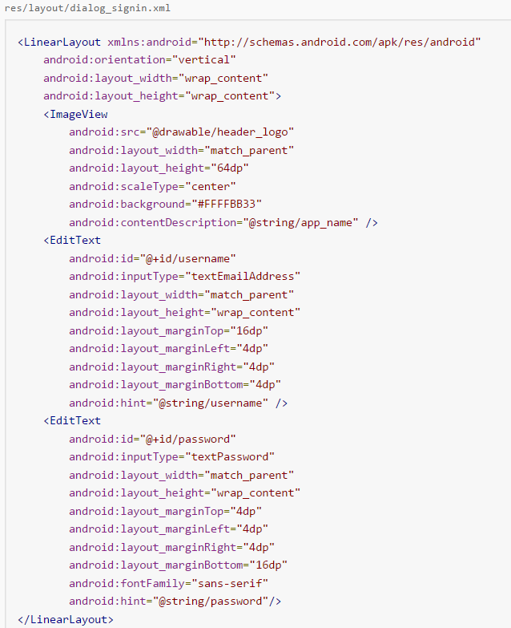
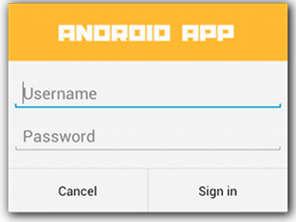
Example of Custom Dialog

Slide 31
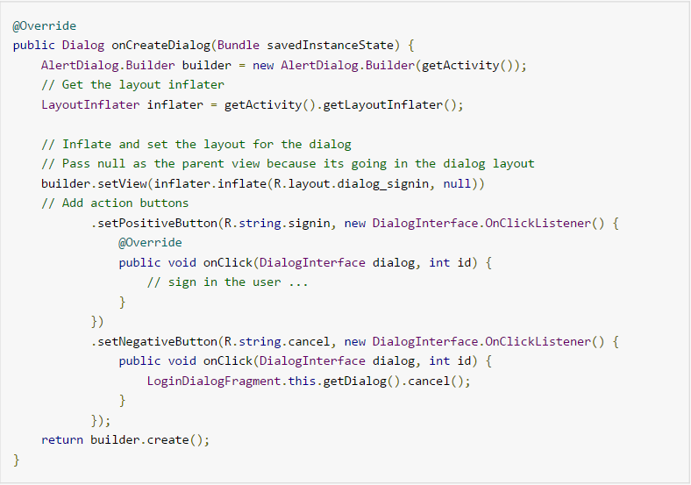
Sample DialogFragment

Slide 32
Working with Support Package Dialog Fragments
The previous example will work only on devices that are running Android 3.0 (API Level 11) or newer
If you want your DialogFragment implementation to work on devices running older versions of Android, you must make a few small changes to the code
Doing so will allow your DialogFragment to work on devices all the way back to Android 1.6 (API Level 4)

Slide 33
Working with Support Package Dialog Fragments
First, we must import the support version of the DialogFragment class
  android.support.v4.app.DialogFragment
Then, just as before, you need to implement your own DialogFragment class
  This class simply needs to be able to return an instance of the object that is fully configured and needs to implement the onCreateDialog method, which returns the fully configured AlertDialog, much as it did using the legacy method

Slide 34
Working with Support Package Dialog Fragments
public class MyAlertDialogFragment extends DialogFragment {
public static MyAlertDialogFragment
newInstance(String fragmentNumber) {
MyAlertDialogFragment newInstance =
new MyAlertDialogFragment();
Bundle args = new Bundle();
args.putString("fragnum", fragmentNumber);
newInstance.setArguments(args);
return newInstance;
}
...
}
Notes:
The following code is an implementation of a simple DialogFragment that manages an AlertDialog.
This defines a method for instantiating a new instance of a DialogFragment.

Slide 35
Working with Support Package Dialog Fragments
public class MyAlertDialogFragment extends DialogFragment {
...
@Override
public Dialog onCreateDialog(Bundle savedInstanceState) {
final String fragNum = getArguments().getString("fragnum");
AlertDialog.Builder alertDialog = new AlertDialog.Builder(getActivity());
alertDialog.setTitle("Alert Dialog");
alertDialog.setMessage("This alert brought to you by " + fragNum );
alertDialog.setIcon(android.R.drawable.btn_star);
alertDialog.setPositiveButton(android.R.string.ok,
new DialogInterface.OnClickListener() {
@Override
public void onClick(DialogInterface dialog, int which) {
((SimpleFragDialogActivity) getActivity()).doPositiveClick(fragNum);
return;
} });
return alertDialog.create();
}
}
Notes:
This code, similar to the example examined early in this presentation, uses the onCreateDialog method to create a new AlertDialog.

Slide 36
Working with Support Package Dialog Fragments
Now that you have defined your DialogFragment, you can use it within your Activity like any Fragment
  But this time you must use the support version of the FragmentManager by calling getSupportFragmentManager()
In your Activity file, you need to import two support classes for this implementation to work
  android.support.v4.app.DialogFragment
  android.support.v4.app.FragmentActivity
Be sure to extend your Activity class from FragmentActivity, and not Activity as in the previous example, or your code will not work
The FragmentActivity class is a special class that makes fragments available with the Support Package

Slide 37
Working with Support Package Dialog Fragments
public class SupportFragDialogActivity extends FragmentActivity {
@Override
public void onCreate(Bundle savedInstanceState) {
super.onCreate(savedInstanceState);
setContentView(R.layout.main);
Button launchAlertDialog = (Button) findViewById(R.id.Button_AlertDialog);
launchAlertDialog.setOnClickListener(new View.OnClickListener() {
public void onClick(View v) {
String strFragmentNumber = "Fragment Instance One";
DialogFragment newFragment =
MyAlertDialogFragment.newInstance(strFragmentNumber);
showDialogFragment(newFragment, strFragmentNumber);
}
});
}
...
}
Notes:
The following FragmentActivity class, called SupportFragDialogActivity, has a layout resource that contains a Button control, which triggers a new instance of the MyAlertDialogFragment to be generated and shown.

Slide 38
Working with Support Package Dialog Fragments
  public class SupportFragDialogActivity extends FragmentActivity {
  ...
  void showDialogFragment(DialogFragment newFragment,
  String strFragmentNumber) {
  newFragment.show(getSupportFragmentManager(),
  strFragmentNumber);
  }
  public void doPositiveClick(String strFragmentNumber) {
  Toast.makeText(getApplicationContext(),
  "Clicked OK! (" + strFragmentNumber + ")",
  Toast.LENGTH_SHORT).show();
  }
  }
Notes:
Here we can see the showDialogFragment method calling the show() method of the DialogFragment class for displaying the Dialog, in addition to the doPositiveClick method that will display a Toast message to the user.

Slide 39
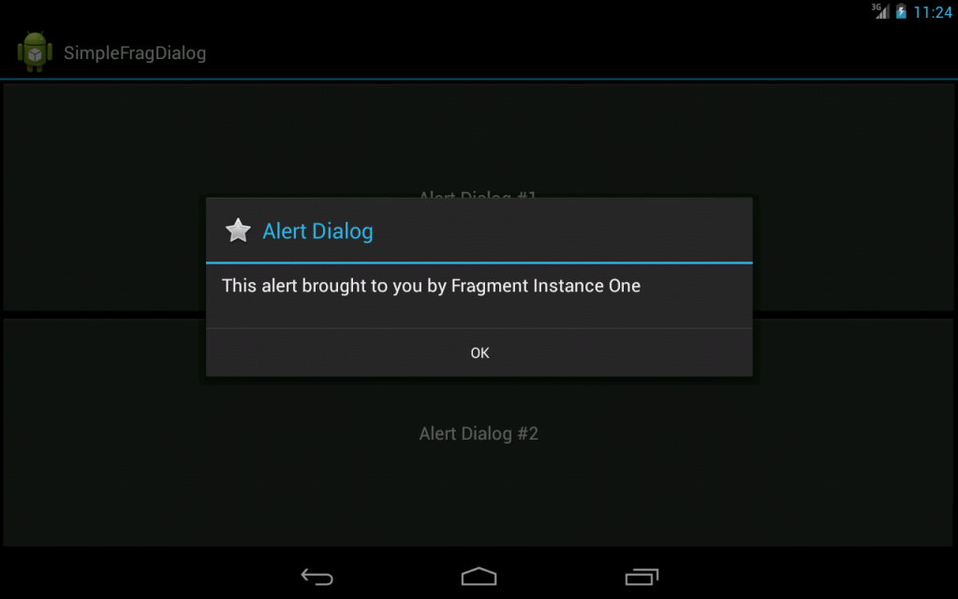
Working with Support Package Dialog Fragments
Notes:
This screen capture shows a FragmentActivity using a DialogFragment to display a Dialog to the user with the Support Package.

Slide 40
Working with Support Package Dialog Fragments
DialogFragment instances can be traditional pop-ups (as shown in the previous slide) or they can be embedded like any other Fragment
You may want to embed a Dialog in these circumstances:
  You’ve created a picture gallery application and implemented a custom Dialog that displays a larger image when you click a thumbnail
  On small-screen devices, you might want this to be a pop-up Dialog
  But on a tablet or TV, you might have the screen space to show the larger graphic off to the right or below the thumbnails
  This would be a good opportunity to take advantage of code reuse and simply embed your Dialog

Slide 41
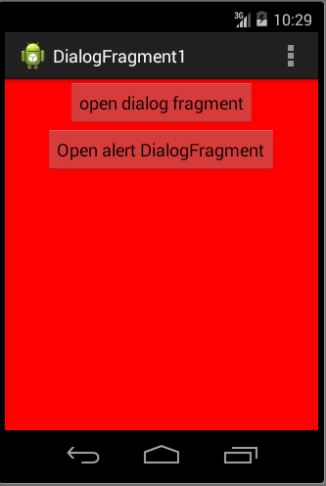
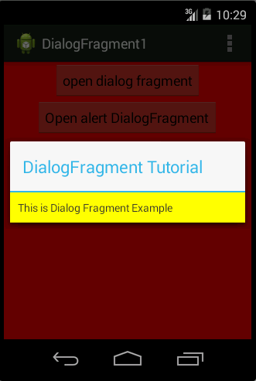
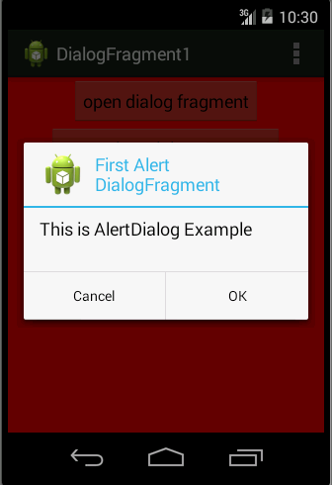
Example

Slide 42
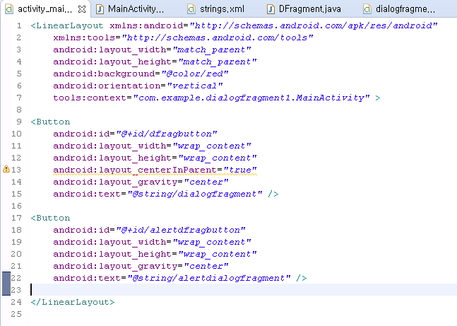
activity_main.xml

Slide 43
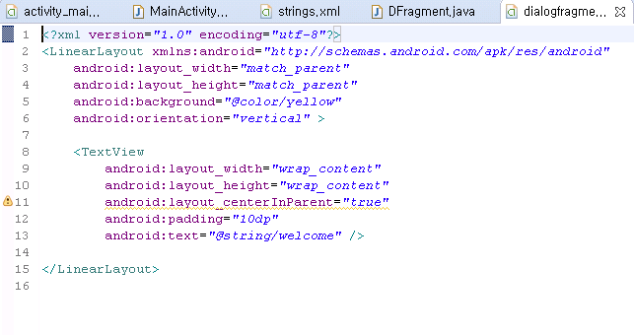
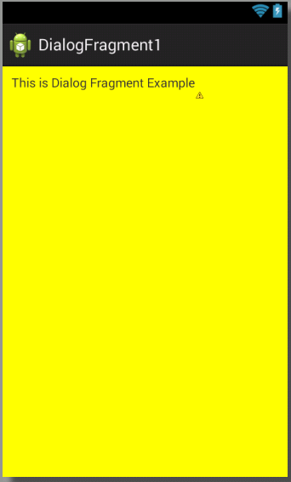
dialogfragment.xml

Slide 44
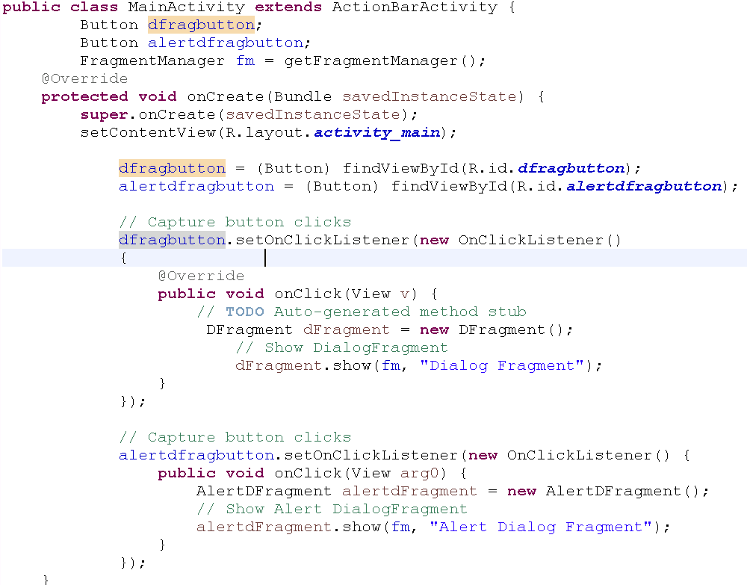
MainActivity.java

Slide 45
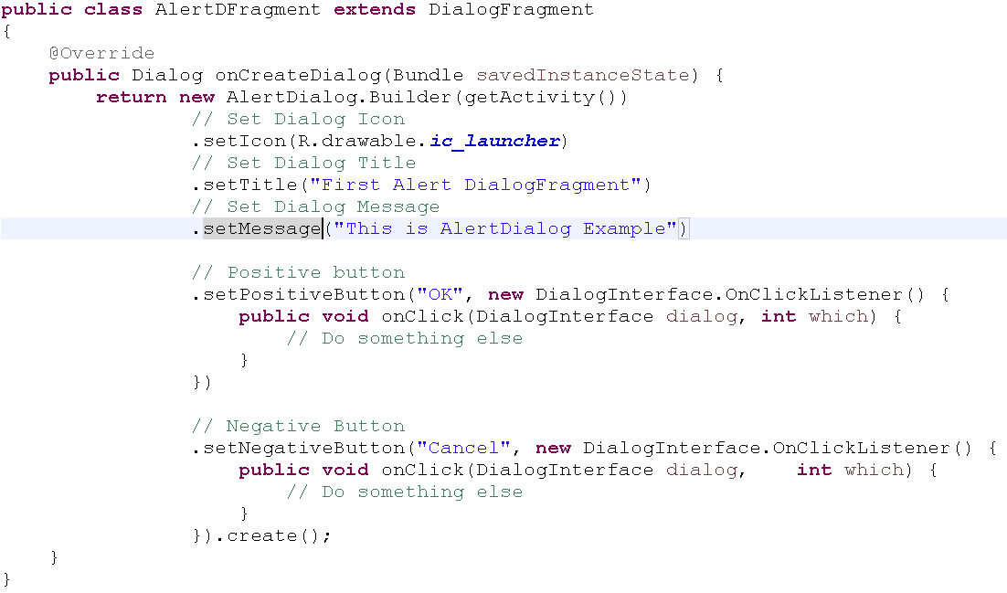
AlertFragment.java

Slide 46
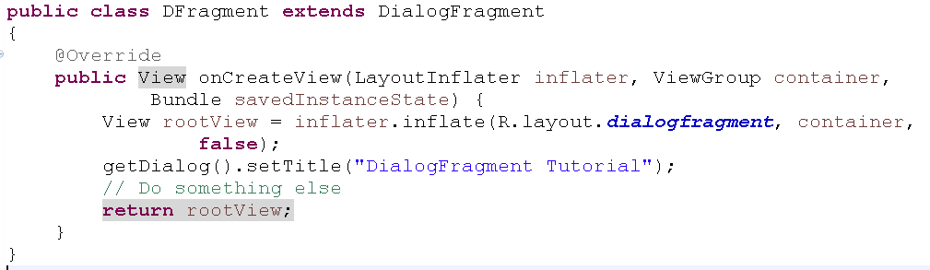
DFragment.java

